Slide 1

AMR public health risk assessment for veterinary medicines in the EU
Application of VICH GL 27
Presentation for the VOF, November 2020
Presented by Helen Jukes
National Seconded Expert, Veterinary Division, European Medicines Agency

Slide 2
Disclaimer
These slides have been provided for training purposes only. The presenter has made every attempt to ensure that they are consistent with relevant VICH guidelines.
As always, the original Guideline(s) should be used as the primary source of information for working with regulators.
Please note that at the time of publication of these slides, the EMA/CVMP’s Guideline on the assessment of the risk to public health from antimicrobial resistance (EMA/CVMP/AWP/706442/2013) is in draft.

Slide 3
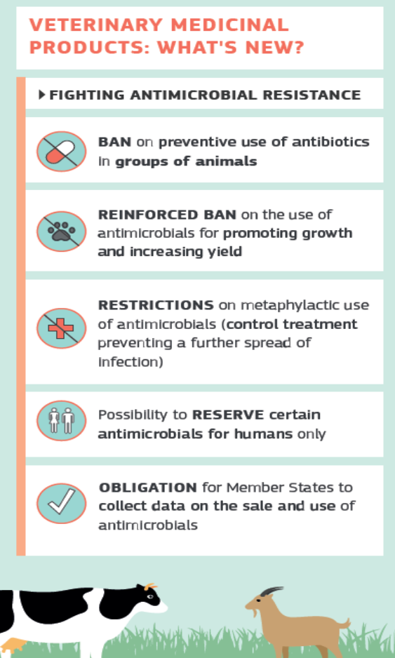
Legislative background in the EU
Regulation (EU) 2019/6 on veterinary medicinal products comes into application on 28th January 2022
It includes a wide range of measures to implement the European One Health Action Plan against AMR
In addition to the key measures (right), the regulation aims to stimulate the development of new antimicrobial veterinary medicinal products (VMPs)

Slide 4
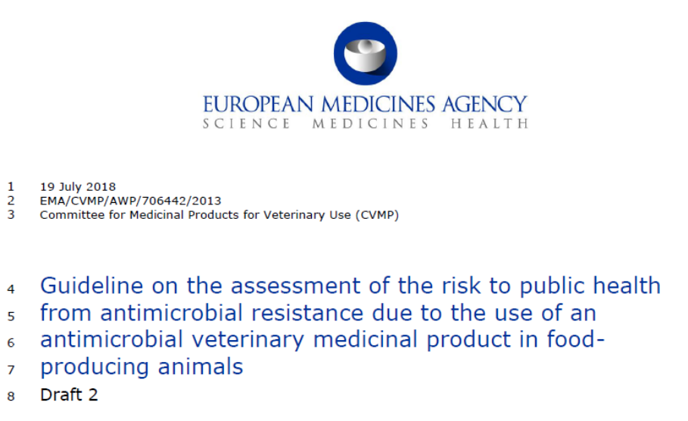
Regulation (EU) 2019/6
Applications for marketing authorisation for antimicrobial VMPs must include documentation on the risks to public health and information about risk management measures to limit the development of AMR (Article 8)
The data requirements are laid out in Annex II to the regulation.
Guidance on risk assessment is provided in VICH GL 27 and the EMA/CVMP’s Guideline on the AMR risk to public health (draft):

Slide 5
EMA/CVMP’s Guideline on the AMR risk to public health due to use of an antimicrobial VMP in food-producing animals
The risk question to be addressed is:
What is the risk to human health from antimicrobial-resistant bacteria resulting from the intended use of the proposed veterinary medicinal product?
VICH GL27 Pre-approval information for registration of new VMPs for food-producing animals with respect to AMR
Objective:
…characterization of the potential for a given antimicrobial agent to select for resistant bacteria of human health concern.

Slide 6
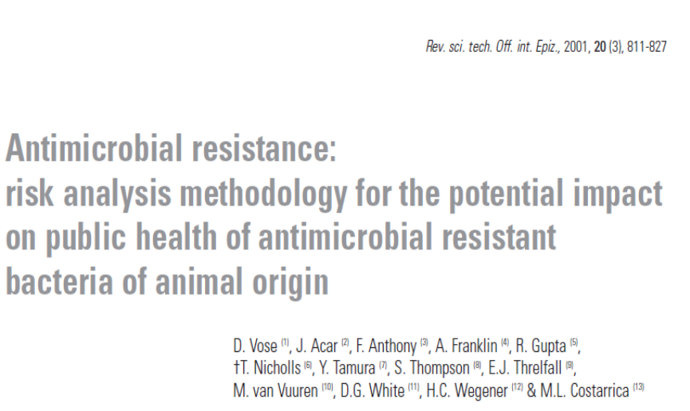
EMA/CVMP’s Guideline on the AMR risk to public health
The methodology is adapted from the OIE (Terrestrial Animal Health Code, chapter 6.10)
It also takes note of:
Codex CAC/GL 77-2011
Requirements from other jurisdictions (USA, Canada, Australia, Japan)

Slide 7
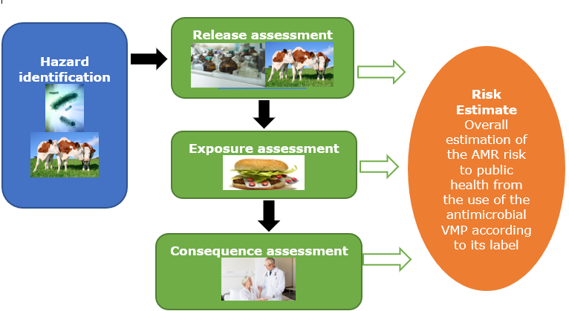
EMA’s GL on the AMR risk to public health: Methodology

Slide 8

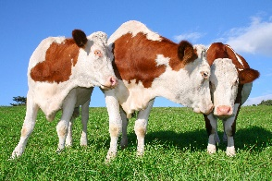
Hazard identification
EU: Identification of zoonotic AMR bacteria, or AMR genes in commensal bacteria, that are selected by the use of the antimicrobial in the target animal and could be involved in a human illness.
Data recommended in EU | Detail | Applicability to GL 27
Antimicrobial substance-specific information. | Antimicrobial class, mode of action, spectrum of activity | VICH GL 27, section 1.1 to 1.3
Bacterial spp. in the target animal in which resistance to the antimicrobial may be of public health relevance | Foodborne pathogens (Campylobacter, Salmonella) Bacteria transmitted by direct contact (Staph. aureus) Indicator/commensal bacteria that may carry transferrable resistance determinants (E coli, Enterococcus) | VICH GL 27, section 1.3.3 GL 27 addresses foodborne route only and does not consider AMR transfer to humans via animal contact
Susceptibility data for these bacteria | MIC data derived with validated methods | VICH GL 27, section 1.3
Resistance mechanisms, genetic basis of resistance and location of determinants | Intrinsic resistance and acquired resistance due to chromosomal mutation or through mobile genetic elements | VICH GL 27, section 1.4
Cross- and co-resistance | To both other human and/or veterinary antimicrobials | VICH GL 27, sections 1.6 and 1.7

Slide 9

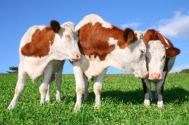
Release assessment
EU: Probability that the hazard (resistant bacteria) will be selected and ‘released’ following the use of the antimicrobial veterinary medicine under its proposed conditions (target animal, route of administration, etc.)
Data recommended in EU | Detail | Applicability to GL 27
Product description and conditions of use | Product formulation and route of administration. Animal species, disease indication and prevalence. Extent of use. | Taken into account in VICH GL 27, for the Discussion (section 3)
Pharmacokinetics and PKPD Concentration of antimicrobial in intestinal tract | ADME in target animal, PKPD and potential for selection of resistance in hazard bacteria that are part of the intestinal microbiota. | VICH GL 27, sections 1.8 and 2.2
Occurrence and rate of transfer of resistance determinants | In vivo or in vitro mutation frequency and transfer studies. | VICH GL 27, sections 1.5, 2.1 and 2.3
Prevalence of zoonotic and indicator bacteria in animal population and prevalence of AMR in those bacteria | Epidemiological data. May be obtained from EU mandatory monitoring. | Not explicitly a requirement of VICH GL 27.

Slide 10

Exposure assessment
EU: Amount of human exposure to the hazard (resistant bacteria) through food or animal contact and the probability of its occurring
GL27 does not account for post-slaughter factors that affect the potential human health impact.
Data recommended in EU | Detail | Applicability to GL 27
Human Consumption patterns for food produce from target animals |  | Not a requirement of VICH GL 27
Prevalence of food contamination and microbial load at point of consumption, prevalence of resistance in those bacteria | Data may be available from EU and national monitoring. Secondary contamination due to processing etc. is excluded. | Not a requirement of VICH GL 27
Data from source attribution studies | Where available. | Not a requirement of VICH GL 27
Characterisation of extent of human exposure through direct contact | Relates to those occupationally exposed (rearing, slaughter, processing) | Not a requirement of VICH GL 27

Slide 11

Consequence assessment
EU: Potential adverse health effects in humans after exposure to the hazards (resistant bacteria, resistance genes), the severity and probability of those consequences
Data recommended | Detail | Applicability to GL 27
Relative importance of the antimicrobial to human medicine | Infectious diseases in humans for which the antimicrobial is a treatment and availability of alternatives. Extent of use. | Not a requirement of VICH GL 27
Dose-response relationship | Threshold of exposure required to cause infection in susceptible humans | Not a requirement of VICH GL 27
Consequences of resistance to the antimicrobial in humans | Severity of the disease, mortality, impact of loss of treatment options, increased burden on health services | Not a requirement of VICH GL 27

Slide 12
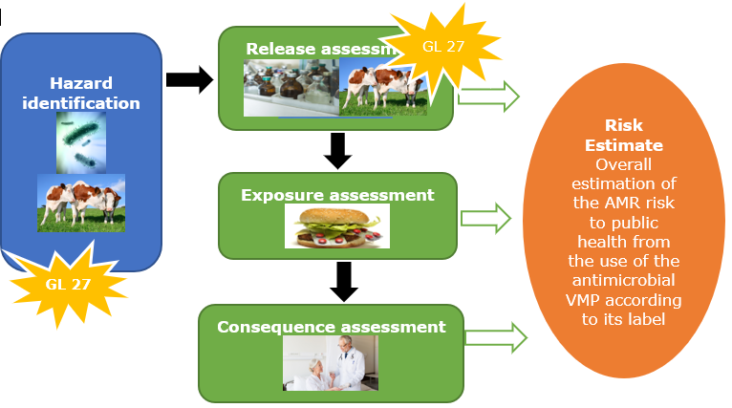
Overall risk estimation

Slide 13
Final comments
Data outlined in VICH GL 27 are suitable for the ‘hazard identification’ and ‘release assessment’ (in part) for the EU AMR public health risk assessment for new antimicrobial VMPs for food-producing animals
Additional data are recommended on human ‘exposure’ and ‘consequences’ for the AMR public health risk assessment according to the EU guideline
The EU risk assessment is tailored to the conditions of use (antimicrobial formulation, animal species, disease, etc) of the proposed VMP (as also mentioned in GL 27:Discussion)
EU guidelines also require consideration of the AMR risk due to transfer of resistant bacteria from animals to humans by the direct contact route (animals or their produce)

Slide 14

Further information
https://www.ema.europa.eu/en/assessment-risk-public-health-antimicrobial-resistance-due-use-antimicrobial-veterinary-medicinal
https://www.ema.europa.eu/en/veterinary-regulatory/research-development/scientific-guidelines/safety-residues/safety-residues-antimicrobials
helen.jukes@ema.europa.eu
zoltan.Kunsagi@ema.europa.eu
Official address Domenico Scarlattilaan 6 ● 1083 HS Amsterdam ● The Netherlands
Address for visits and deliveries Refer to www.ema.europa.eu/how-to-find-us
Send us a question Go to www.ema.europa.eu/contact Telephone +31 (0)88 781 6000
Follow us on @EMA_News
Notes:
Note: This slide is OPTIONAL. It uses the 'Closing slide' layout. Delete if not needed.

